Slide 1
STUDENT NAME : SAKTHIVEL A
NAAN MUDHALVAN ID : au713921106045
EMAIL ID : sakthivel08022002@gmail.com
PROJECT TITLE : ENVIRONMENTAL MONITORING
PHASE-2 : INNOVATION

Slide 2
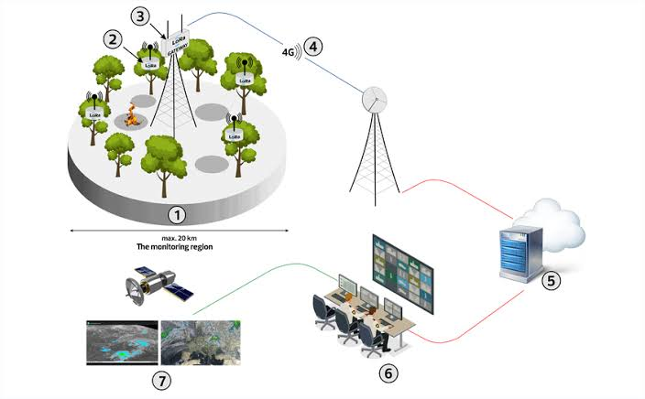
IOT Based Environmental Monitoring System
IOT is newly developed technology in which the connectivity between physical objects along with controllers, actuators and sensors synchronized over an Internet. 10T able to provide means to monitor the quality of parameters like Air, Noise, Temperature, Humidity and Light [2]. It helps concern authorities to take action against pollution crossing beyond defined level.

Slide 3
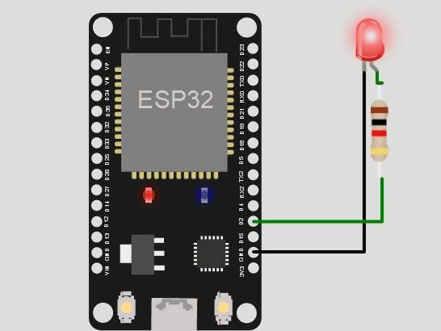
ESP32 Simulation
The ESP32 is a popular WiFi and Bluetooth-enabled microcontroller, widely used for IoT Projects.
Wokwi simulates the ESP32, ESP32-C3, ESP32-S2, ESP32-S3, ESP32-C6 (beta), and ESP32-H2 (alpha).

Slide 4

Iot communication technology
system of interconnected physical devices that communicate via network connectivity using various communications protocols

Slide 5
Application layer
The application layer serves as the interface between the user and the device within a given IoT protocol

Slide 6
IOT Protocol
Advanced Message Queuing Protocol (AMQP)
Constrained Application Protocol (CoAP)
Data Distribution Service (DDS)
Wi-Fi/802.11
Message Queue Telemetry Transport (MQTT)
Transport layer
Transmission Control Protocol (TCP)

Slide 7
Conclusion
The many of the IoT project are used to the ESP32 and Wokwi platforms.
This is the one of the way to simulate the Arduino UNO and other sensors such as temperature sensor, humidity sensors, etc..,
IoT communication technology and their protocols are helpful to improve and controls the our projects.

